Slide 1
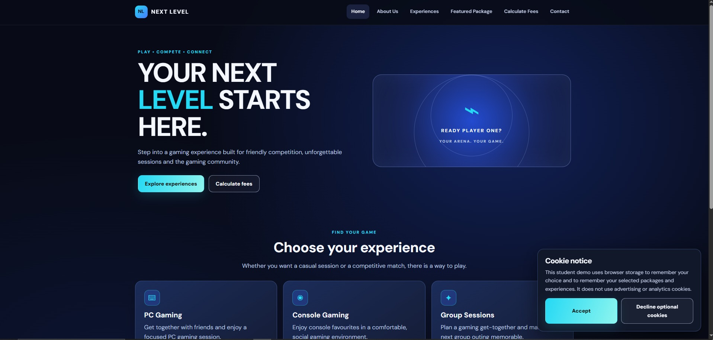
TEAM ROSE PRESENTS
NEXT LEVEL
GAMING & ESPORTS ARENA
Website design, page-by-page
walkthrough and functionality
PLAY • COMPETE • CONNECT
A modern gaming destination designed to help visitors explore, compare and enquire.
Group members: Bokang, Gcina, Esihle, Onako and Henoc
Group presentation | 2026
TEAM ROSE

Slide 2
PRESENTATION OUTLINE
TEAM MEMBER 1
How we will present our website
Our group will introduce the design, explain the pages and demonstrate how visitors use the website.
1.
Introduce the project and explain the website's purpose, target users and design choices.
TEAM MEMBER 1
2.
Present the Next Level logo and explain the branding, colours and wireframe layouts.
TEAM MEMBER 2
3.
Walk through the Home page, explain its sections and demonstrate what its buttons do. Then explain the About Us page.
TEAM MEMBER 3
4.
Present the Experiences page and Featured Package page, including their information and navigation links.
TEAM MEMBER 4
5.
Demonstrate the Calculate Fees page, explain the Contact page, customer journey, accessibility and conclude.
TEAM MEMBER 5
All members
TEAM ROSE • NEXT LEVEL GAMING & ESPORTS ARENA
02

Slide 3
01 / PROJECT INTRODUCTION
TEAM MEMBER 1
What is Next Level?
The purpose of the website and the experience it is designed to provide.
• Our project is a website for Next Level Gaming & Esports Arena. It introduces the gaming arena and gives visitors a central place to learn about the business and its example gaming experiences.
• The website is intended for people who enjoy gaming, friends who want to play together and groups who may be interested in a shared gaming session.
• Visitors can read about the business, explore PC Gaming, Console Gaming and Group Sessions, view the featured PC Gaming package, estimate session fees and find the Contact page.
• Our aim is to make the website visually exciting while keeping the information organised and the navigation simple.
TEAM ROSE • NEXT LEVEL GAMING & ESPORTS ARENA
03

Slide 4
02 / DESIGN DECISIONS
TEAM MEMBER 1
Why did we choose this design?
The visual style supports the gaming theme while keeping information easy to read.
• We chose a dark navy and black background because it creates a modern, technology-focused gaming atmosphere and allows the brighter interface elements to stand out.
• Cyan is used for important headings, highlighted words and primary buttons. It attracts attention and helps visitors identify the main actions on each page.
• Blue tones are used in panels, cards and decorative areas to create depth while keeping the pages visually consistent. White text provides clear contrast against the dark background.
• We used bold headings, short paragraphs, rounded cards and consistent spacing so that users can scan the content instead of facing one large block of text.
• The navigation remains in the same position across the pages. This consistency helps visitors understand where they are and how to move to another section.
TEAM ROSE • NEXT LEVEL GAMING & ESPORTS ARENA
04

Slide 5
03 / LOGO AND IDENTITY
TEAM MEMBER 2
The Next Level logo
The logo connects the name of the application to its gaming purpose.
• The logo uses the letters “NL” inside a bright blue rounded square, followed by the words “NEXT LEVEL”.
• The letters NL are a short and recognisable version of the application name. The bright mark makes the brand easy to notice against the dark header and footer.
• The name Next Level communicates improvement, progress and taking gaming skills or experiences to a higher level.
• The tagline “PLAY • COMPETE • CONNECT” supports the idea that the arena is not only about playing games, but also about friendly competition and spending time with other people.
• We repeat the same logo treatment in the header and footer to keep the brand consistent throughout the website.
TEAM ROSE • NEXT LEVEL GAMING & ESPORTS ARENA
05

Slide 6
04 / WIREFRAMES
TEAM MEMBER 2
How the wireframes guided the website
Wireframes are the planning stage that shows where content and controls should appear.
• The wireframes help us plan the structure of each page before applying the final colours, typography and decorative styling.
• We planned a consistent header area for the logo and navigation, a main content area for the page information, and a footer containing the website identity and project information.
• The Home page wireframe gives priority to the main heading and the two important actions: exploring experiences and calculating fees.
• Content pages use clear headings and grouped sections or cards so that users can compare information and identify the buttons that take them to the next step.
• The final website keeps the same general goal: make the page structure predictable, keep related information together and make important actions easy to find.
TEAM ROSE • NEXT LEVEL GAMING & ESPORTS ARENA
06

Slide 7
05 / WEBSITE WALKTHROUGH
TEAM MEMBER 3
Home page — the starting point
The Home page introduces the arena and gives visitors clear routes to the other sections.
• The header displays the NL logo and the Next Level name.
• The navigation links are Home, About Us, Experiences, Featured Package, Calculate Fees and Contact.
• The hero heading says “Your next level starts here” and introduces the gaming experience.
• “Explore experiences” opens overview.html, where visitors can read about the available gaming options.
• “Calculate fees” opens calculate-fees.html, where visitors can estimate a session cost.
• The lower feature cards introduce PC Gaming, Console Gaming and Group Sessions.
TEAM ROSE • NEXT LEVEL GAMING & ESPORTS ARENA
07

Slide 8
06 / HOME PAGE ACTIONS
TEAM MEMBER 3
What do the Home page buttons do?
Each link directs the visitor to a relevant section rather than acting as decoration.
• “Explore experiences” takes the visitor to the Experiences page. It is useful for someone who wants to compare the gaming options before making a decision.
• “Calculate fees” takes the visitor directly to the fee calculator. It supports visitors who already know what type of session they want and would like an estimated cost.
• “Explore package” on the PC Gaming feature card links to the Featured Package page.
• “View experiences” on the Console Gaming card links to the Experiences page for more information.
• “Ask us about groups” on the Group Sessions card links to the Contact page so that a visitor can ask about group arrangements.
• The navigation links in the header provide another way to move between all the main pages.
TEAM ROSE • NEXT LEVEL GAMING & ESPORTS ARENA
08

Slide 9
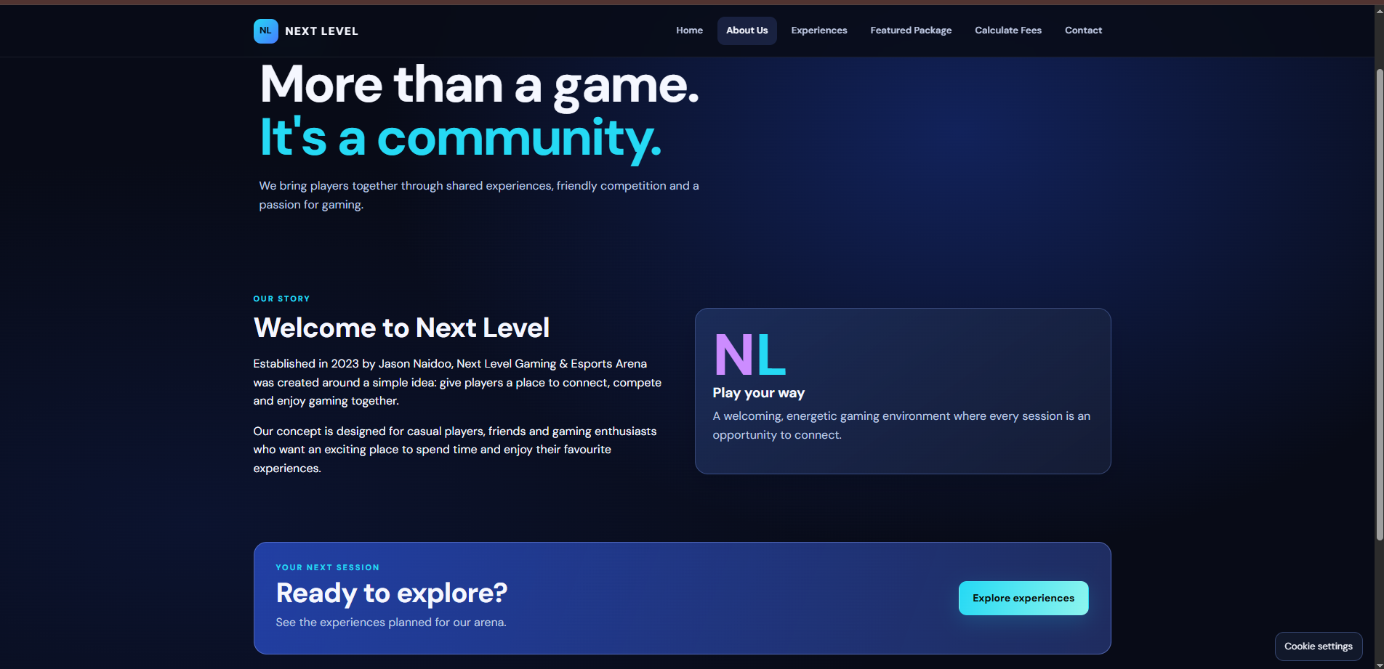
07 / ABOUT US PAGE
TEAM MEMBER 3
About Us — introducing the business
This page explains the story and purpose behind Next Level.
• The About Us page introduces Next Level Gaming & Esports Arena and explains the idea behind the business.
• The supplied page content states that the arena was established in 2023 by Jason Naidoo. It describes the aim of creating a place where players can connect, compete and enjoy gaming together.
• The headline “More than a game. It's a community.” communicates that the business is about shared experiences as well as gaming.
• The “Welcome to Next Level” section gives visitors more background about the arena and the people it is intended to serve.
• The “Play your way” information panel reinforces the welcoming and social atmosphere.
• The “Explore experiences” button takes visitors to the Experiences page so they can move from learning about the business to exploring its services.
TEAM ROSE • NEXT LEVEL GAMING & ESPORTS ARENA
09

Slide 10
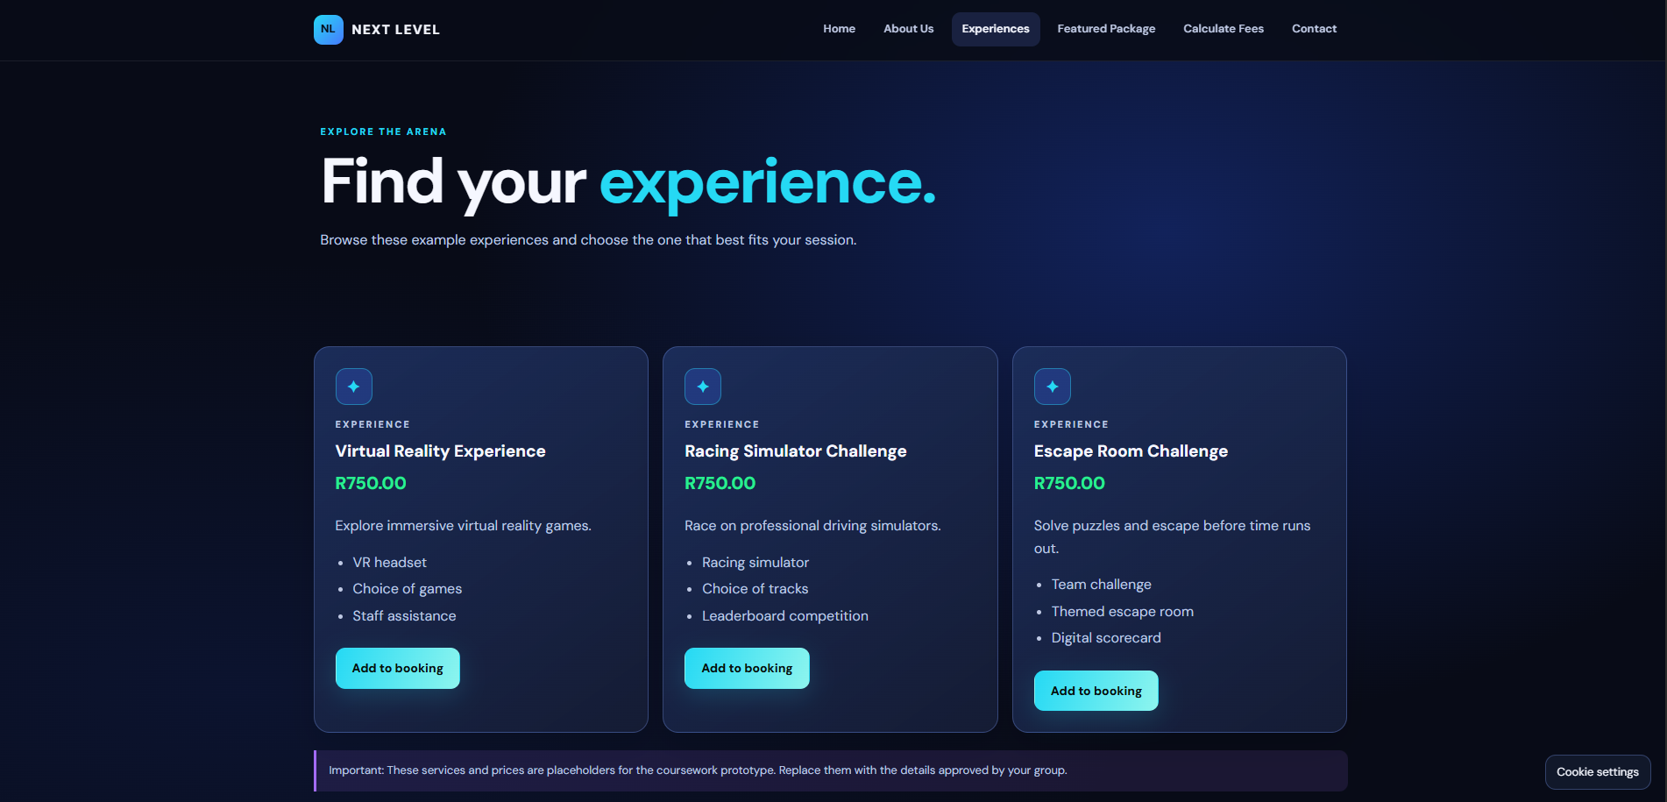
08 / EXPERIENCES PAGE
TEAM MEMBER 4
Experiences — choosing how to play
This page presents the gaming options in separate cards so visitors can compare them.
• The Experiences page is designed for visitors who want to see the available gaming activities in more detail.
• The PC Gaming Session card describes a focused PC gaming session for solo players or friends. The supplied example rate is R50 per hour.
• The Console Gaming card describes a comfortable and social console session. The supplied example rate is R40 per hour.
• The Group Gaming card is intended for people planning a shared session. The page says to ask about availability and request a quote.
• Each card includes a title, short description and a list of details. This makes the information easier to scan and compare.
• The “View details” buttons on the PC and Console cards open the Featured Package page. The “Request information” button on the Group card opens the Contact page.
• The page includes a notice explaining that the services and prices are placeholders for the coursework prototype.
TEAM ROSE • NEXT LEVEL GAMING & ESPORTS ARENA
10

Slide 11
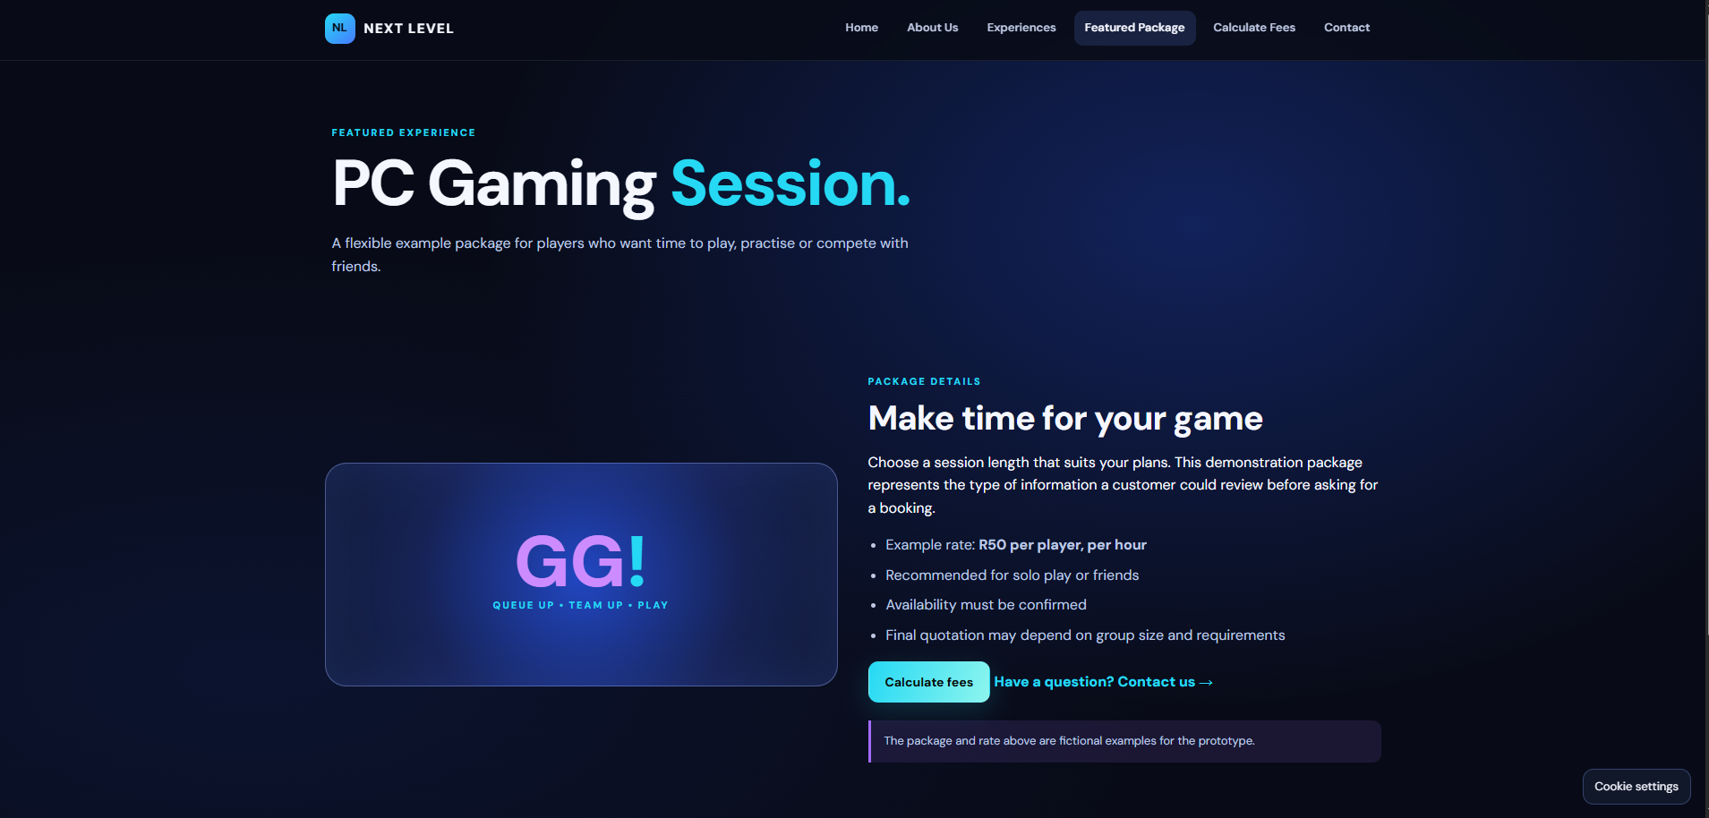
09 / FEATURED PACKAGE PAGE
TEAM MEMBER 4
Featured Package — PC Gaming Session
The package page gives visitors more detail about one example experience.
• The Featured Package page focuses on a PC Gaming Session. It explains that the package is intended for players who want time to play, practise or compete with friends.
• The large “GG!” graphic and the words “QUEUE UP • TEAM UP • PLAY” reinforce the gaming identity and make the section visually different from a normal text-only page.
• The package details state an example rate of R50 per player, per hour.
• The page also explains that the session can suit solo players or friends, availability must be confirmed, and the final quotation may depend on group size and requirements.
• The “Calculate fees” button takes the visitor to the calculator page.
• The “Have a question? Contact us” link takes the visitor to the Contact page.
• The page clearly labels the package and rate as fictional examples for the student prototype.
TEAM ROSE • NEXT LEVEL GAMING & ESPORTS ARENA
11

Slide 12
10 / CALCULATE FEES PAGE
TEAM MEMBER 5
Calculate Fees — estimate a session cost
The calculator asks for three details and calculates an example session estimate.
• The visitor first chooses a gaming experience from a drop-down list: PC Gaming at R50 per hour or Console Gaming at R40 per hour.
• The visitor then enters the number of players. The supplied form allows a value from 1 to 20 and starts with 1 player selected.
• The visitor enters the number of hours per player. The supplied form allows 1 to 12 hours and starts with 2 hours selected.
• When the visitor presses “Calculate estimate”, the form is submitted for calculation and the result area is intended to display the estimate.
• The “Good to know” panel explains that the calculator provides an estimate only. Visitors should contact the team to ask about availability, group requirements and final pricing.
• The supplied HTML shows the form and result area. The exact calculation formula is implemented in script.js, which was not included in the code shared for this presentation.
TEAM ROSE • NEXT LEVEL GAMING & ESPORTS ARENA
12

Slide 13
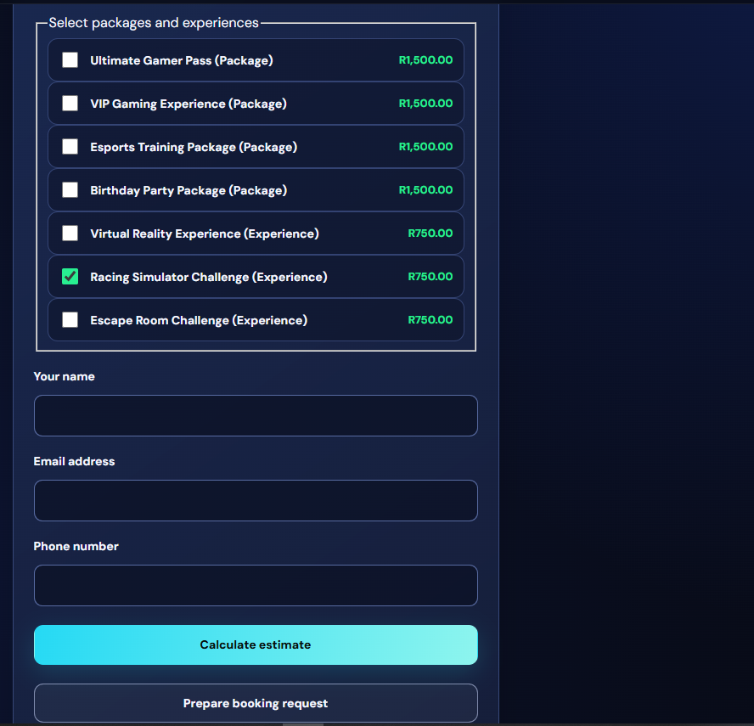
11 / CALCULATOR CONTROLS
TEAM MEMBER 5
What does each calculator field and button do?
The form collects the information needed to estimate a gaming session.
• “Gaming experience” is a selection field. The user chooses PC Gaming or Console Gaming, and the displayed hourly rate differs for each option.
• “Number of players” is a number field. It records how many people will take part in the session.
• “Hours per player” is another number field. It records how long each player plans to play.
• “Calculate estimate” submits the selected experience, number of players and hours so the website can work out an estimated cost.
• The result area initially displays “Your estimate will appear here.” After a successful calculation, the result is intended to appear in this area.
• The Contact us link in the information panel gives visitors a route to ask the team for a confirmed quote.
TEAM ROSE • NEXT LEVEL GAMING & ESPORTS ARENA
13

Slide 14
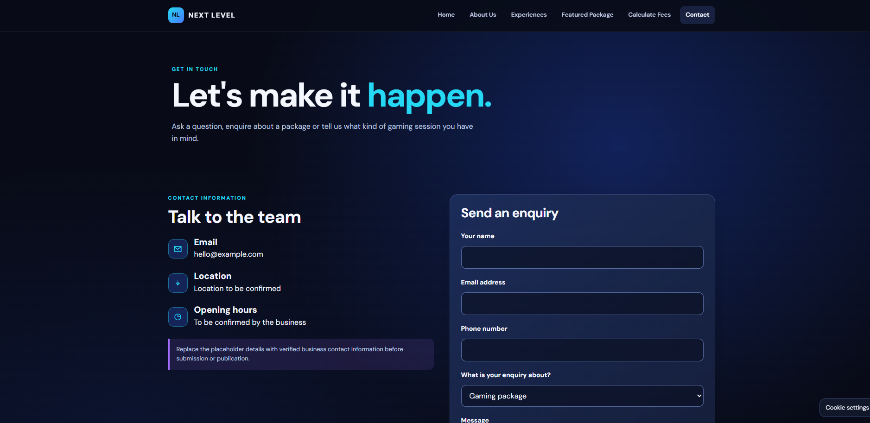
12 / CONTACT PAGE
TEAM MEMBER 5
Contact — the next step for enquiries
The Contact link is included in the website navigation and several page actions.
• The Contact page is included in the main navigation, allowing visitors to find the business contact section from any page.
• The Home page Group Sessions card uses “Ask us about groups” to direct visitors to Contact.
• The Group Gaming card on the Experiences page uses “Request information” to direct visitors to Contact.
• The Featured Package page includes “Have a question? Contact us”, and the calculator information panel also includes a Contact us link.
• The Contact page HTML was not included in the code supplied for this presentation, so its exact fields, contact details and form behavior should be demonstrated from the working website rather than assumed from the other pages.
TEAM ROSE • NEXT LEVEL GAMING & ESPORTS ARENA
14

Slide 15
13 / CUSTOMER JOURNEY
TEAM MEMBER 5
How the pages work together
The website is organised to guide visitors from discovery to an enquiry.
• First, the visitor arrives on the Home page and learns what Next Level offers.
• If the visitor wants to learn about the business, they open About Us. If they want to compare gaming options, they open Experiences.
• After choosing an option, the visitor can open the Featured Package page to read more about the PC Gaming Session.
• The visitor can then open Calculate Fees, select an experience, enter the number of players and hours, and request an estimate.
• If the visitor needs more information or a confirmed quote, the website provides links to the Contact page.
• This journey gives users more than one way to reach important sections: they can use the main navigation or the relevant buttons and links within each page.
TEAM ROSE • NEXT LEVEL GAMING & ESPORTS ARENA
15

Slide 16
14 / USABILITY
TEAM MEMBER 5
Responsive design and accessibility
The website uses common interface features to make navigation clearer.
• The HTML includes a viewport setting so the pages can adapt to the width of different devices.
• The header includes a menu toggle button with an accessible label and an expanded-state attribute. The linked JavaScript is intended to control the mobile navigation.
• Navigation links use clear names such as Home, About Us, Experiences and Contact so visitors can understand where each link leads.
• The calculator fields have visible labels connected to their input controls. This helps users identify what information they need to enter.
• The calculator result area uses a status role and polite live announcement so assistive technology can be informed when the result changes.
• The dark background, bright cyan highlights and light text create a strong visual contrast. The site should still be tested with accessibility tools and on different screen sizes before real-world publication.
TEAM ROSE • NEXT LEVEL GAMING & ESPORTS ARENA
16

Slide 17
15 / HOW THE WEBSITE IS BUILT
TEAM MEMBER 5
HTML, CSS and JavaScript
The supplied code separates the page structure, appearance and interactive behaviour.
• HTML creates the structure of each page, including the header, navigation, headings, cards, form fields, buttons and footer.
• CSS controls the visual presentation, including the dark gaming background, colours, typography, spacing, card layouts and responsive behaviour.
• JavaScript is linked to the pages through script.js. It is used for interactive behaviour such as the menu toggle and the fee calculation.
• The code supplied for this presentation includes the Home, About Us, Experiences, Featured Package and Calculate Fees page structures. The package page appears twice in the pasted code.
• The project should be presented as a student website prototype. The prices are explicitly described as examples, and availability and final pricing need to be confirmed.
• Before a real launch, the website would need verified business details, full testing and any required server-side services for live bookings or enquiries.
TEAM ROSE • NEXT LEVEL GAMING & ESPORTS ARENA
17

Slide 18
16 / CONCLUSION
TEAM MEMBER 5
A clear website journey for Next Level
Team Rose — Next Level Gaming & Esports Arena
• The Home page introduces the arena and directs visitors to the main sections.
• The About Us page explains the business story and community purpose.
• The Experiences page presents PC Gaming, Console Gaming and Group Gaming.
• The Featured Package page gives more detail about the example PC Gaming Session.
• The Calculate Fees page allows visitors to estimate a session using the experience, number of players and hours.
• The Contact links give visitors a way to ask questions and request further information.
• Together, these pages create a consistent and easy-to-follow website experience that reflects the gaming identity of Next Level.
THANK YOU
Questions?
TEAM ROSE • NEXT LEVEL GAMING & ESPORTS ARENA
18

Slide 19
References
1. Gordon, K. (2020) ‘5 Principles of Visual Design in UX’. Nielsen Norman Group. [online] Available at: https://www.nngroup.com/articles/principles-visual-design/ (Accessed: 12 November 2026).
2. MDN Web Docs (2025) Learn web development. [online] Available at: https://developer.mozilla.org/en-US/docs/Learn_web_development (Accessed: 12 November 2026).
3. MDN Web Docs (n.d.) Web developer guides. [online] Available at: https://developer.mozilla.org/en-US/docs/MDN/Guides (Accessed: 12 November 2026).
4. Team Rose (2026) Next Level Gaming & Esports Arena website prototype. Original group project screenshots and website design.
5. World Wide Web Consortium (W3C) (2024) Web Content Accessibility Guidelines (WCAG) 2.2. [online] Available at: https://www.w3.org/WAI/standards-guidelines/wcag/ (Accessed: 12 November 2026).

